Slide 1

What next?
UCAS CAO
Notes:
Good morning everyone.
I am going to talk about the important work we will be doing with the girls in the Careers Department this term.
I will also address the application procedure for university and Mrs O’Hare will give you a brief overview of student finance.
This term we will begin our preparation for the UCAS and CAO applications for entry to university or college.
Some girls may already have attended various Open Days both in person and virtual and others will attend in the coming weeks. The girls have also had experience of career areas and work placements related to their areas of interest.

Slide 2
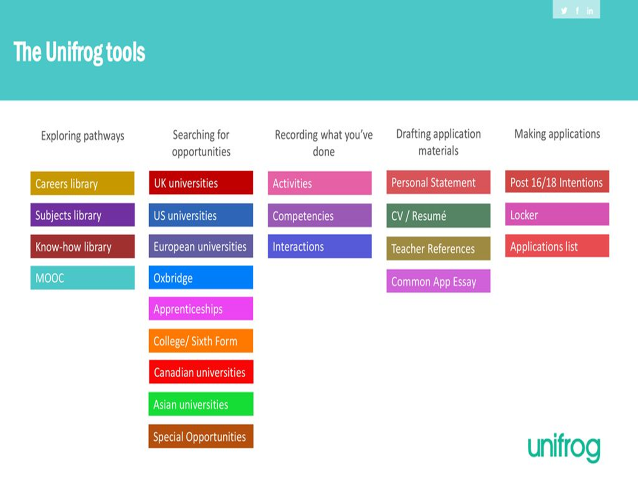

Notes:
As part of this preparation, all Year 14 students are registered on the Unifrog platform giving them access to a range of career and progression information. Students will continue to use their online accounts to research their progression options and make use of the exploring pathway interactive tools.
Students can record details of their experiences of work, employer and university engagements, and shortlist their research and intended destinations on the Unifrog system. This enables the girls to develop their ideas and plan their next steps appropriately.
Unifrog enables students to compare every university course, every apprenticeship and Further Education course so that they can make the right choices for them, and then apply successfully.

Slide 3
UCAS
University & Colleges Application System
Universities in N.I. – QUB and UU
England
Scotland
Wales
Notes:
UCAS is the university and college admissions system through which the students apply to Queen’s University Belfast, the Univ. of Ulster or universities in England, Scotland and Wales.
They can also apply to some Apprenticeships through UCAS.

Slide 4
NURSING
BSc Nursing - University of Ulster
BSc Nursing/Midwifery Sciences - QUB
Notes:
They can also use UCAS to apply for Nursing in NI and across the water.

Slide 5
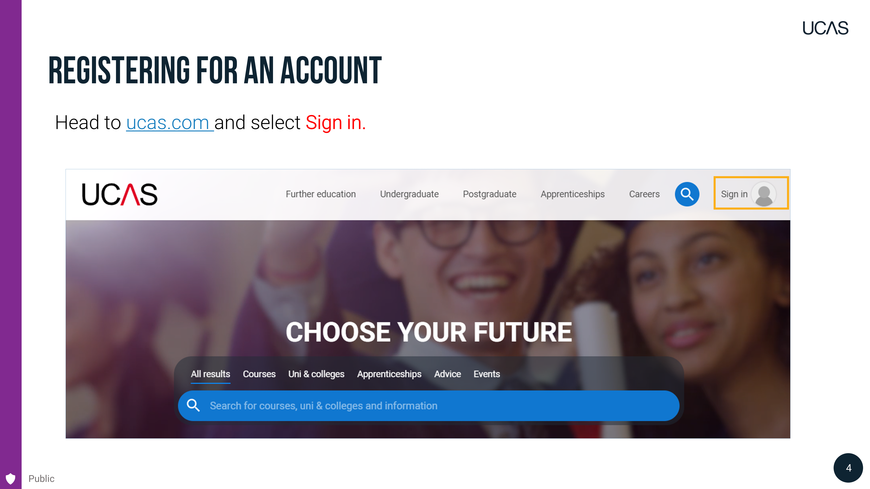
Notes:
The first thing the girls will do is register with UCAS and attach themselves to the UCAS centre of Mount Lourdes.
We will guide them through this process later this morning.

Slide 6
UCAS Application
Personal details
Education
Employment
Extra Activities
Personal Statement
Choices – up to 5
Cost: £28.95
Notes:
The application consists of several sections:
Personal details
Education
Employment
Extra Activities
Personal Statement
Choices – a maximum of 5 courses can be selected. These can be at the same institution or different institutions.
The cost of the application is £28.95 – means tested.

Slide 7
UCAS Deadlines
2nd October
15th October - Oxford and Cambridge; Medicine, Dentistry, and Veterinary Medicine/Science (School deadline 8th October)
14th January 2026 – UCAS deadline for all other courses
**School deadline – 15th December 2025**
Notes:
It is essential to adhere to the UCAS deadlines throughout the application process.
15th October - Deadline for applications to the universities of Oxford and Cambridge, and for most courses in medicine, dentistry, and veterinary medicine/science.
14th Jan – All other course deadline.
However – as the academic reference for each student must be attached before the form can be submitted – the school deadline for UCAS is STRICTLY 15th December 2025.
We ask for your cooperation in supporting these deadlines.

Slide 8
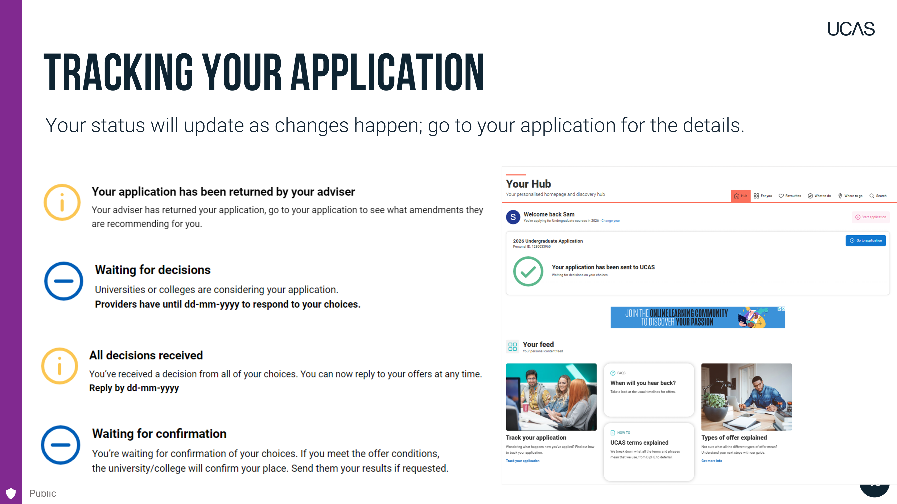
UCAS Application
Notes:
Once the application has been submitted, it can be tracked online. Students can see if they have any interview invitations, the conditions that must be met for any course offers, or any course rejections. This should be checked regularly.

Slide 9
UCAS Extra – 26th Feb. 2026
An opportunity to look for a course if you are eligible. You are eligible if :
All initial 5 choices have been used and
You have NO offers or
You have declined any offers received.
Notes:
If a student does not receive any offers or they have decided to decline them all, they can still find other courses through, what is called, the UCAS Extra system. In this case students can apply for one course at a time until they are happy with the course offered.
A student will use the UCAS extra system if:
They receive no offers or
They change their mind about what or where they want to study.
This process will be explained again in class.

Slide 10
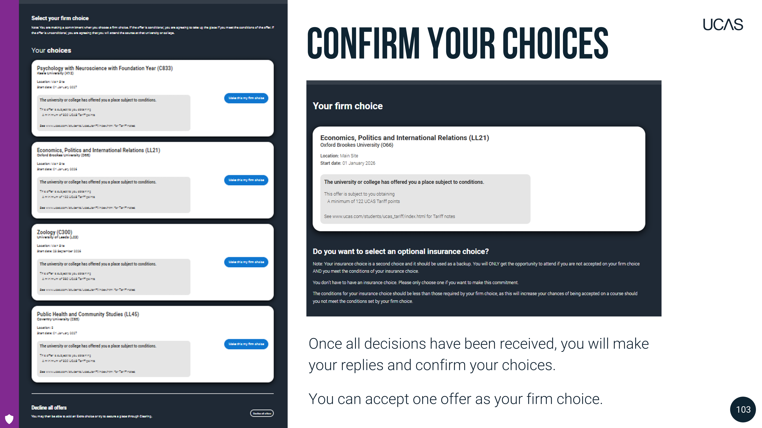
Notes:
Once all decisions have been received, students will make their replies and confirm their choices.
They can accept one offer as their firm choice.
If they choose a conditional offer – which requires certain grades - as their firm choice, they have the option to add an optional insurance choice.
If they choose an unconditional offer as their firm choice, they cannot have an insurance choice.
Some girls may receive unconditional offers. This means that they are offered a place regardless of their A level results. Some universities are now making unconditional offers. If the student accepts an unconditional offer from a university, they only have this one choice so they would need to be very sure about the university and the course to do this.
The girls should consider their predicted grades carefully when making these choices and should speak to their Careers teacher about it if they are unsure.
It can be tempting to accept an unconditional offer but if a student changes their mind about their course choice, they will not be able to change it. Another possible outcome is that the student decides they don’t need to work as hard for their exams and – their A level grades suffer. This can become a problem later down the line.
We will talk about the Firm and Insurance choice and about unconditional offers in class with the girls.

Slide 11
Colleges of Further Education
South West College
Belfast Metropolitan College
North West Regional College
South East College
Notes:
Not all students plan to go directly to university.
We also encourage the girls to research and apply to courses in Colleges of Further Education such as SW College. This is a good pathway for many students and these courses can also lead onto degree course study if so desired.
In this case students usually apply directly to the college however some of these courses are also in the UCAS system.

Slide 12

Apprenticeships
www.successatschool.org
Notes:
Students can also apply for an apprenticeship.
In this case students can gain a qualification, in some cases a degree, work and earn money all at the same time.
If awarded an apprenticeship the Employer\ Education Authority pays any university fees.
Apprenticeship opportunities are common in the areas of law, accountancy, finance, engineering and digital technology.
Any apprenticeship information that we receive is shared with the girls but as there are many hundreds of degree apprenticeship opportunities out there so independent research is also required.
A good place to start is on the website: www.successatschool.org – there is a link to this page through the school website.

Slide 13
Republic of Ireland
Central applications system for the Republic of Ireland - CAO:
Universities
Institutes of Technology
Teacher Training Colleges
College of Surgeons
Notes:
I am now going to talk briefly about applying to southern universities…
CAO is the Central Applications System for the Republic of Ireland Institutions.
We will begin working on this application system for those who are interested when we finish with the UCAS applications. This includes girls who are studying 3 or 4 A levels, as well as Applied subjects.
In CAO up to 20 course choices can be made and there is no personal statement, so the girls find it a bit easier to apply.
They can apply for up to 10 Hons degree courses and 10 ordinary degree or higher certificate courses, some of which are in the Institutes of Technology which are a great option for some students – especially with the cost of higher education fees in the UK, and across the water in particular.
Any offers for CAO are made after the results in August – not before.

Slide 14
Results Day
Grades required achieved
Adjustment Process
Clearing
Notes:
Reassuringly, most students normally get into their 1st course choice.
Next August, hopefully you'll get the exam grades you need to get onto your chosen course.
However, you may be accepted even if you fall short of the initial grades required….but you might have to wait a few days or even up to a few weeks to find out.
If the first-choice course is not achieved, the insurance choice course – with lower grade requirements is the next option.

Slide 15
UCAS Clearing Service
To be eligible for a clearing place means that you either:
Have no offers; or
Your firm and insurance choices have made you unsuccessful
www.ucas.com/clearing
Notes:
In the unfortunate situation when a student holds no offers after the exam results ……they can use the Clearing service to get on to a course of their choice.
However, don’t panic and end up in a situation where you accept a course that you are not interested in……..just to go
university!
Again, we will cover this in class. The UCAS website will provide the required information.

Slide 16
Results Day
Need help?
Careers Department
Notes:
Members of the Careers department will be available in school to support and advise you with any queries or problems that arise next August. Please don’t hesitate to contact us at those times.
For those who are unhappy with a result………….you can get a remark…
However, You will need to try to arrange the re-mark as quickly as possible and stay in touch with your university or college to keep them up to date.
Thank you for listening ….I will now hand you over to Mrs O’Hare who will guide you through the very important area of student Finance.

Slide 17
Student Finance
Tuition fees
Living costs – accommodation and day-to-day living expenses
Notes:
And now moving on to the very important area of Student Finance.
The cost of Third Level education falls into two categories:
Course tuition Fees and
Living Costs which includes accommodation and any day-to-day living expenses.

Slide 18
Finance: Tuition Fees
Northern Ireland £4,855
England, Scotland and Wales max £9,535
Notes:
So, first of all, – tuition fees. This information is for the current year and all the information that I give you is subject to change.
For the current 2025-26 academic year the max fee for NI students studying in NI is £4,855. For courses in England, Scotland and Wales fees may be charged up to the maximum of £9,535.
The difference in these figures explains the high demand for places on courses in NI institutions and the need to research all possible options for next year.
The girls need to check with any institution to which they are interested in applying, to find out the fees for the course they wish to study. Student loans will be available to pay tuition fees up to the max of £9,535. These loans are not means tested so do not depend on family income but do have to be repaid.
So - all students are entitled to a loan to pay university tuition fees.

Slide 19
Finance: Living costs
Maintenance/Special Support Grants
( a grant does not have to be repaid)
Maintenance Loans
( a loan does have to be repaid)
Notes:
And now on to student living costs.
Student living costs are met either through:
Maintenance or special support grants; or
Maintenance loans which depend on household income and student eligibility.
I will talk through both these options briefly now.

Slide 20
Finance: Maintenance Grants
If household income less than approx. £19,203 will receive £3,475 per annum non-repayable.
Partial non-repayable grants up to household income of £41,065.
Notes:
First of all, maintenance grants. In the current year students with a household income of less than approx. £19,203 will receive the full, non-repayable Government grant of £3,475 per annum.
If you have a household income of less than £41,065 your daughter will be eligible for a partial grant which is non-repayable.

Slide 21
Finance: Special Support Grant
Worth up to £3,475 a year
Special Support Grant is available to students who have any special circumstances which mean they are eligible for income support or housing benefit
Non-repayable
Notes:
The Special Support Grant has the same value as the maintenance grant, and is available to students with any special circumstances which leave them eligible for income support or housing benefit such as having a disability or a dependent.
Again the special support grant does not have to be repaid by the student.

Slide 22
Finance: Maintenance loans
If household income above £41,540 students are eligible to borrow the maintenance loan which will have to
be repaid.
Notes:
Moving on to students from households with incomes greater than approx. £41,500. These students will be able to avail of a maintenance loan which will have to be repaid. The amount of the loan available to each student will be based on parental income.

Slide 23
Finance: Maintenance Loans
Maximum living expenses loan
Home £6,300
Lodgings £8,132
London £11,391
Notes:
All maintenance loans must be repaid in instalments when the student starts working and once income exceeds approx. £26,000 per year.
The loan repayment period for NI students ends after 25 years whether the loan is repaid or not.

Slide 24
Finance: Grants, bursaries and scholarships
In Queen’s University, new students can compete to receive one (or more) of eight awards worth between £600 to £2,400.
Ulster university also have a range of Scholarships available. Some are for students who get high grades and others are for students in financial need.
Notes:
Many universities award grants, bursaries and scholarships to students which do not have to be repaid.
Some of these are awarded automatically as a result of the information provided to Student Finance NI, however, some need to be applied for. We encourage the girls to research any such possibilities within their chosen universities.
For example, In Queen’s University, new students can compete to receive one (or more) of eight awards worth between £600 to £2,400.
UU have a wide range of scholarships available that require research also.
Sports scholarships are often available too.

Slide 25
Finance
Must apply to Education Authority to be eligible for any grant or loan in UK or Republic of Ireland.
All applications made at: www.studentfinanceni.co.uk
Notes:
Applications for all financial support, including loans, must be made to student finance ni via www.studentfinanceni.co.uk
These applications will be available in March 2026.

Slide 26
Republic of Ireland: Fees
Currently no tuition fees
Student Contribution fee 3,000 euros 2025-26
Funded by student loan
Apply through EA as before
Not means tested
Contribution Fee Loan available
Repayable
SUSI funding
Notes:
At the minute tuition fees do not apply in the CAO system in the ROI but that may change in the future. There is however an annual student contribution charge of up to 3000 euros – a loan can be obtained to pay this fee. This loan is non means tested and is also repayable.
The Maintenance Loan, that I talked about earlier, is also available to all eligible students studying in the ROI.
Students may also be eligible for funding from the ROI awarding body SUSI. Separate applications must be made independently to SUSI for this.

Slide 27
Medicine and Dentistry
DoH bursary in year 5+ of study anywhere in UK
Years 1-4 have the same finance arrangements as for any other higher education student.
Notes:
There are some different arrangements for selected courses.
Any pre-registration student of medicine or dentistry from Northern Ireland will receive a Department of Health bursary in their fifth and later years of study, regardless of where you study in the UK.
Support for the first four years of study will be on the same basis as for other higher education students.

Slide 28
Health Professional Courses
Physiotherapy, Occupational Therapy, Chiropody, Dental Hygiene/Therapy, Orthoptics, Radiography, Speech and Language Therapy, Paramedic Science, Podiatry or Dietetics:
Income assessed bursary
Tuition fees paid
NI and Wales institutions only (Commit to working in Wales for 2 years)
Notes:
At the minute there are also different financial arrangements for health professional courses.
For Health Professional courses such as Physiotherapy, Occupational Therapy, Radiography etc there is a non-repayable, income assessed bursary. If a student receives this bursary the amount of loan they can get is then reduced.
Tuition fees for these courses are also automatically paid.
Our current understanding of this evolving situation regarding NHS courses is that this applies to NI and Welsh institutions only and is only for students who commit to working in Wales for 2 years after they qualify. Students who apply to study elsewhere will pay fees and do not receive a bursary.

Slide 29
Nursing and Midwifery
Tuition fees paid
Means tested DoH bursary (£5,165)
NI and Wales only (Commit to working in Wales for 2 years)
Notes:
Nursing and midwifery degree students also get their tuition fees paid in any NI institution by the Department of Health and are eligible for a means tested bursary of approx. £5000 to help with living costs.
There are eligibility requirements for these bursaries.
Our current understanding is that this applies to NI and Wales only – subject to eligibility, Not institutions in England or Scotland . Students who apply to study Nursing in England may be eligible for the Learning Support Fund.
If you intend to study in England, Scotland or Wales, you should contact the relevant funding body for further information on the support available.

Slide 30
Social Work
Students studying social work in NI will get extra funding from DHSS
DHSS – non means-tested bursary, contribution to work based learning expenses
NI ONLY
Notes:
Currently students studying Social Work in NI get extra financial assistance from the Dep. Of Health and Soc. Services (DHSS). They receive a non means tested bursary of £4000 and financial help towards any work-based learning such as expenses for a placement.

Slide 31
Disabled Students Allowance
Grants to pay for extra costs
Not income assessed
Non-repayable
Notes:
There is additional financial help available for students who have a disability, mental health condition or a specific learning difficulty.
These non-repayable grants pay for any extra costs that may arise, for eg, for special equipment such as a laptop.

Slide 32
Further Education Award
Courses at South West college or similar
Maximum award of approx. £2000
Apply through: www.studentfinanceni.co.uk
Notes:
Further Education awards are also available for students going on to courses at local colleges such as South West College or Belfast Metropolitan College. Applications are also made to Student Finance NI.

Slide 33
How to Contact EA
All applicants for financial assistance is made to Student Finance NI not the school
Student Finance NI, Further Education Awards Section, 1 Hospital Road, Omagh, BT79 OAW
0300 100 0077
www.studentfinanceni.co.uk
Notes:
We will re-visit student finance again in Careers Class in March time, when information is updated for 2026 entry, as figures won’t be finalised until then.
The website listed here studentfinanceni.co.uk really does have excellent additional information and guidance for students and parents. Application Forms are also available online and here are the contact details for the local EA Student Finance department. If you have any doubts or queries you can contact the EA in Omagh or studentfinanceni yourselves at any time.

Slide 34
Useful downloads
https://www.studentfinanceni.co.uk/media/1809/sfni_hyap_guide_2526_o.pdf
https://www.studentfinanceni.co.uk/media/1808/sfni_ft_main_guide_2526_o.pdf
Notes:
These downloads from Student Finance NI have all the information available in more detail and have all the contact details for various funding departments for NHS funding etc.
These are however, the 2025-6 Booklets but they will be updated on the student finance website for the next academic year.

Slide 35
Parents, guardians, and carers
Sign up to receive UCAS emails.
Download UCAS Parent Guide.
Use the parent information tool to guide you through the application process.
Check out the 90 – second parent videos.
Get top tips for your daughter.
Visit www.ucas.com/parents.
Notes:
Just to finish off, I know that I have provided a lot of information that some of you may find confusing, especially if this is your 1st child to go through the process. There is a lot information available on the parent area of the website at www.ucas.com/parents.
I hope you have found the information useful. This presentation is available on the school website for future reference.
Thank you for listening.

